Slide 1
Computer architecture and Organization Memory Organization
M. Khademul Islam, PhD Professor, Dept. of CSE, Rajshahi University, Bangladesh Email: khademul.cse@ru.ac.bd, tel: +88-01727-786600 web: www.ru.ac.bd/cse/~mki

Slide 2
Memory Organization
Memory Hierarchy
Arrangement of different types of memories based on accessibility in computer system
Main Memory: memory unit that communicates directly with the CPU (RAM)
Auxiliary Memory: device that provide backup storage (Disk Drives)
Cache Memory: special very-high-speed memory to increase the processing speed

Slide 3
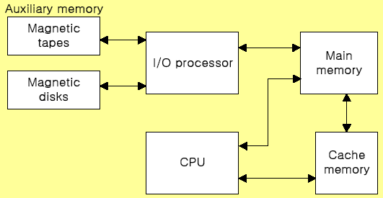
Memory Organization
Memory Hierarchy
Order according to speed: Cache>Main Memory>Auxiliary memory
Order according to size: Cache<Main memory<Auxiliary memory

Slide 4
Memory Organization
Main Memory
Main memory is the only one directly accessible to the CPU.
The CPU continuously reads instructions stored there and executes them as required.
Any data actively operated on is also stored there in uniform manner.
RAM (Random access memory) and ROM (Read only memory) are treated as main memory.

Slide 5
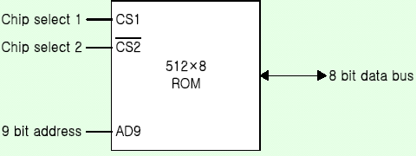
Memory Organization
ROM
Stores a program that helps start up the computer
ROM is non-volatile (holds programs and data even after power off)
ROM is also direct access but only read
The contents of ROM are fixed at the time of manufacture (a typical ROM chip)

Slide 6
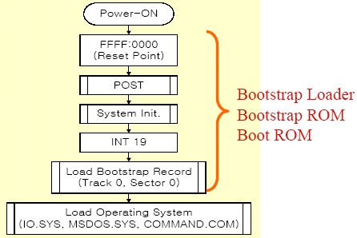
Memory Organization
Bootstrap Loader
A program whose function is to start the computer software operating when power is turned on

Slide 7
Memory Organization
RAM
Its purpose is to temporarily hold programs and data for processing.
Described as being volatile (all data are lost when power off)
It is direct access as it can be both written to or read from in any order

Slide 8
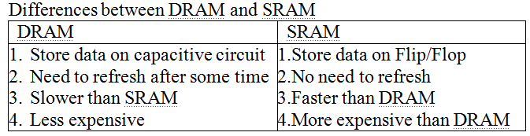
Memory Organization
Types of RAM
Dynamic RAM (DRAM)
The RAM which requires the stored information to be periodically re-written, or refreshed, otherwise it would vanish.
Static RAM (SRAM)
The RAM which never needs to be refreshed as long as power is applied. (It loses its content if power is removed).

Slide 9
Memory Organization
Memory address map
Memory Address Map is a representation of assigned address space for each chip
Assume that a computer system needs 512 bytes of RAM and 512 bytes of ROM
The RAM have 128 byte and need seven address lines, where the ROM have 512 bytes and need 9 address lines

Slide 10
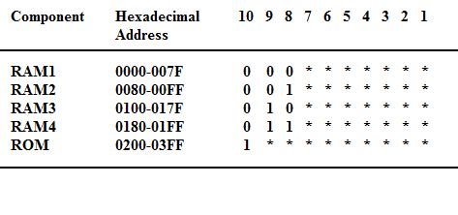
Memory Organization
Memory address map

Slide 11
Memory Organization
Memory Connection with CPU
The hexadecimal address assigns a range of hexadecimal equivalent address for each chip
Line 8 and 9 represent four distinct binary combination to specify which RAM we chose
When line 10 is 0, CPU selects a RAM. And when it’s 1, it selects the ROM

Slide 12
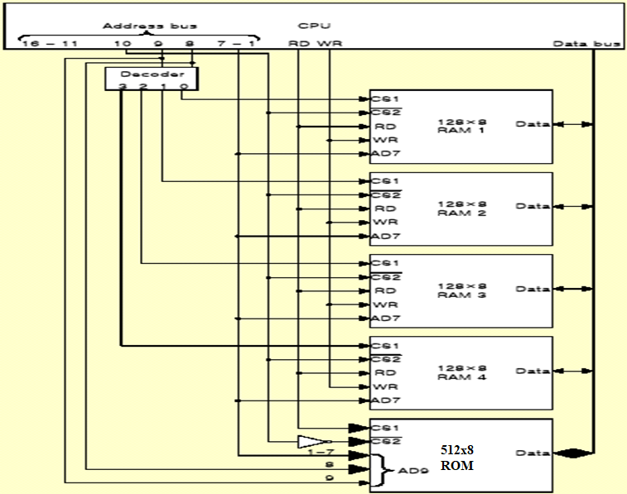
Memory Organization
Memory Connection with CPU

Slide 13
Memory Organization
Cache memory
Small amount of faster memory (SRAM) to speed up computer
Level 1 cache is built within the CPU (internal)
Level 2 cache may be on chip or nearby (external)
Faster for CPU to access than main memory

Slide 14
Memory Organization
Cache performance
Defined as hit ratio
When the CPU refers to memory and finds the word in cache, it is called hit;
If the word is not found in cache it counts miss.
The hit ratio is defined as: hit ratio=hit/(hit+miss).

Slide 15
Memory Organization
Factors of Cache performance
Cache size
Mapping method: associative, direct, set-associative
Replace algorithm: LRU, LFU, FIFO
Write policy: write-through, write-back

Slide 16
Memory Organization
Cache Replacement Algorithm
LRU (Least Recently Used)
LFU (Least Frequently Used)
FIFO (First-In First-Out)
Writing to Cache
Write-through: Cache write and main memory
Write-back: Cache write and set flag to indicate the last writing

Slide 17
Memory Organization
Secondary Storage
Secondary storage (auxiliary storage) is not directly accessible by the CPU.
The computer usually uses its I/O channels to access secondary storage
Transfers the desired data using intermediate area in primary storage.
Secondary storage does not lose data when the device is powered off - non-volatile.

Slide 18
Memory Organization
Virtual Memory
Uses backing storage e.g. hard disk as a temporary location for programs and data where insufficient RAM available
Swaps programs and data between the hard-disk and RAM as the CPU requires them for processing
A cheap method of running large or many programs on a computer system
Cost is speed: the CPU can access RAM in nanoseconds but hard-disk in milliseconds
Virtual memory is much slower than RAM

Slide 19
Memory Organization
Memory Management
Collection of hardware and software for managing the various programs residing in memory.
The basic components of a memory management unit are:
A facility for dynamic storage relocation that maps logical memory references into physical memory addresses
A provision for sharing common programs stored in memory by different users
Protection of information against unauthorized access between users and preventing users from changing operating systems functions.

